Slide 1

Tutorial: Blockchains and Databases
C. Mohan IBM Fellow Distinguished Visiting Professor Tsinghua University, Beijing
IBM Almaden Research Center, San Jose, USA
@seemohan cmohan@us.ibm.com http://bit.ly/CMwIkP
29 August 2017
Links to Videos, Slides, Bibliography & Twitter Handles @ http://bit.ly/CMbcDB

Slide 2
Agenda
Goal: Educate DB people about private/permissioned blockchains (BCs) to convince them to get more involved to improve them
Origin of blockchains
Related distributed systems/databases topics
Evolution: Private BCs, Smart Contracts, …
Applications
Market Scene
Benchmarks
Architectural Choices and Relationship to DB Replication
Technical Details of Representative Systems: Enterprise Ethereum, Hyperledger Fabric, R3 Corda, BigchainDB, Sawtooth, Ripple
Futuristic Topics

Slide 3
Blockchain (BC)
Origin in digital currencies, in particular Bitcoin (Satoshi Nakamoto, 2008) – anonymity, open/public/permissionless environment
Numerous organizations across the world working on various aspects of it: security, consensus, database, benchmarks, …
Banks, regulators, universities, startups, big technology companies, services companies, governments, … individually or as part of consortia
February 2017: First commercial deployment of BC technology by IBM and Guernsey’s Northern Trust for admin of private equity fund managed by Unigestion
July 2017: Hyperledger Fabric 1.0 Released
Hyperledger Fabric on IBM Cloud - IBM Blockchain Platform (formerly HSBN) on highly secure Linux on mainframes (System Z) with security hardware – announced August 2017
Grand View Research: Global BC Tech Market $7.74B by 2024
My focus: Private/Permissioned BC Systems!

Slide 4
Distributed Systems
Distributed operating systems
Distributed virtual memory
Message passing in distributed computations and distributed checkpoints
Clock synchronization and event ordering (e.g., Lamport clocks)
Byzantine agreement and distributed consensus
Two phase commit optimizations (e.g., Presumed Abort)
(Transactional) RPCs and distributed file/object systems
Asynchronous computation via message queues and pub-sub
Distributed event-based systems
Client-server, mobile computing and caching, WWW
Workflow or business process management systems
Service Oriented Architecture (SOA)
Public cloud and hybrid cloud
…

Slide 5
Data Systems
Relational DBMSs (e.g., System R) and SQL
Data consistency, degrees of isolation and fault tolerance
Distributed databases (e.g., R*) and distributed transactions/queries
Synchronous and asynchronous replication with primary copy
Update anywhere (multi-master) replication and eventual consistency
Stored procedures, user-defined types/functions, data provenance, …
Data warehousing and parallel DBMSs – OLTP vs OLAP
Shared Nothing Vs Shared Disks
Object-oriented databases, XML, schema chaos, data integration, …
Web2.0-inspired NoSQL, sharding & massive scaling (e.g., Spanner), JSON, …
Big Data: Map-Reduce, Hadoop, Spark, …
Data privacy, multitenancy and trans-border data flow restrictions
Multi data centers and disaster recovery
…

Slide 6


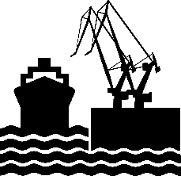






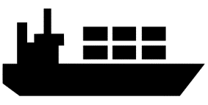

Problem Being Solved
Recording of events is becoming much more complex…
Airport’s records
Bank’s
records
Port’s
records
Airline’s records
Authority's records
Ocean Carrier’s records
… Inefficient, expensive, vulnerable, lack of transparency

Slide 7


Basic Change to Business Processes
Traditional Way
Blockchain Way
Digitally signed,
encrypted
transactions & ledger
Auditor’s records
Auditor
Party A’s records
Clearing House
Party B’s records
Party A
Party B
Bank’s records
All parties have
same replica
of the ledger
Bank
… Inefficient, expensive, vulnerable … Consensus, provenance, immutability, finality

Slide 8
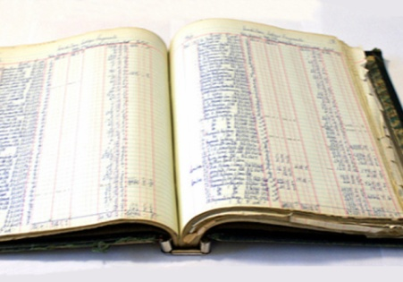
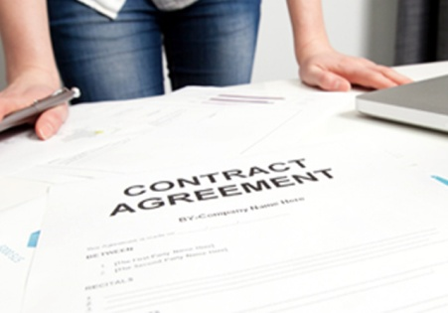


Blockchain for Business
Shared Ledger
Smart
Contract
Business terms embedded in transaction database & executed with transactions
Append-only distributed system of record shared across business network
Ensuring appropriate visibility; transactions are secure, authenticated & verifiable
All parties agree to network verified transaction
Privacy
Consensus
… Broader participation, lower cost, increased efficiency

Slide 9

Overview of Application Flow
Blockchain
developer
develops
Application
D
Developers create application and smart contracts (chaincodes)
Chaincodes are deployed on the network and control the state of the ledger
Application handles user interface and submits transactions to the network which call chaincodes
Network emits events on block of transactions allowing applications to integrate with other systems
Accesses
SDK
develops
Invokes/queries
Smart Contract
emits
event
‘get’
‘put, ‘delete’
emits
Database
block
…
cached state, history, tx
txn
txn
txn
txn
Blockchain
Ledger
Peer
Notes:
Delete can only delete from the World State, not the Blockchain!
A developer will create an application and smart contract (could be different developers)
The application will invoke calls within the smart contract via the Hyperledger Fabric Client (HFC) SDK
Those calls are processed by the business logic within the smart contract
- a ‘put’ or ‘delete’ command will go through consensus protocol selected and added to the blockchain
- a ’get’ command can only read from the world state but is not recorded on the blockchain
An application can access Block information via rest APIs such as get block height

Slide 10
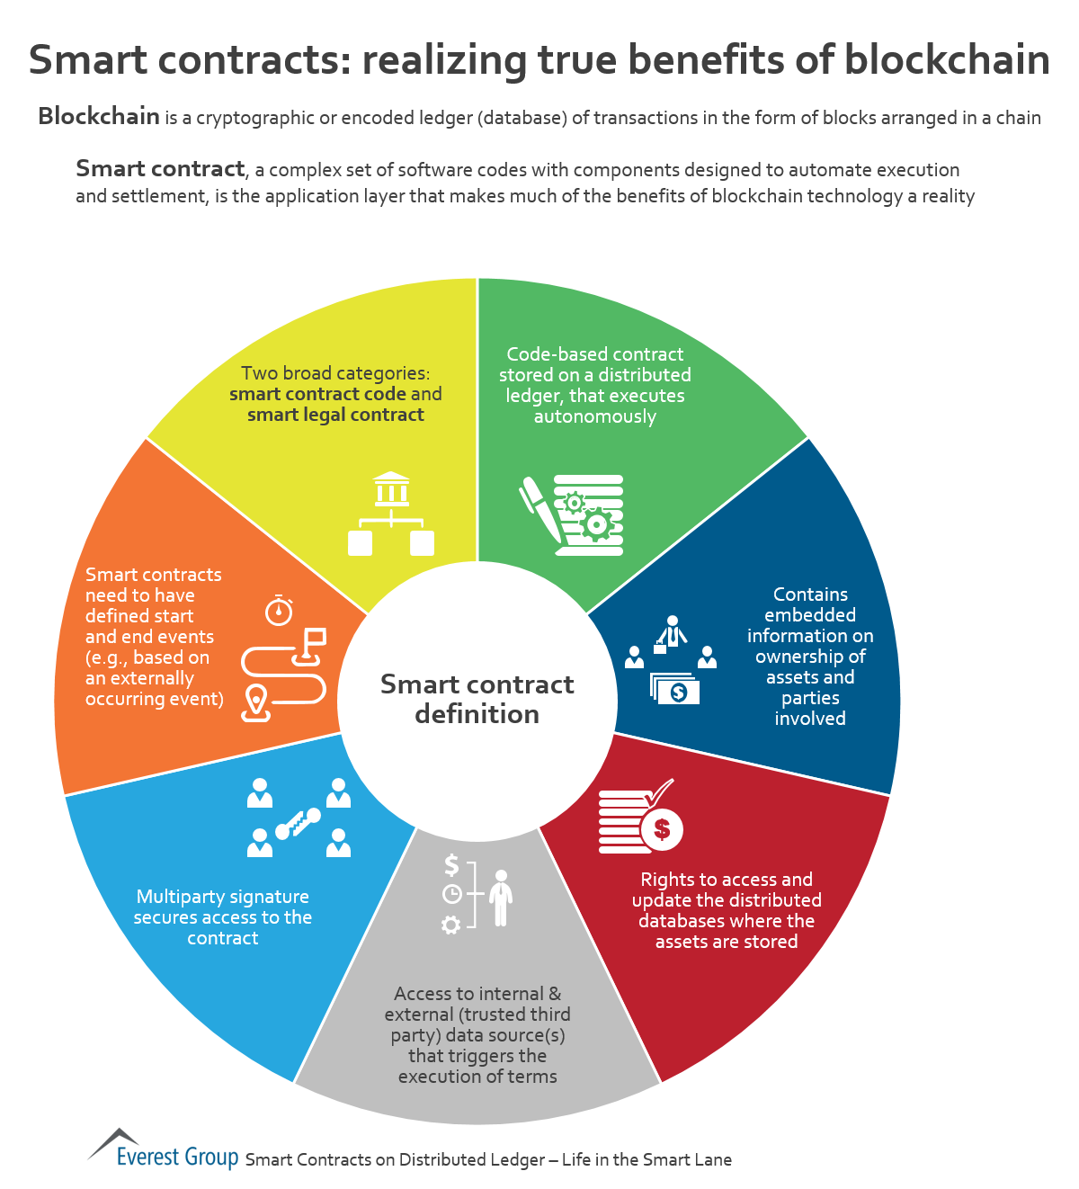
Smart Contracts Everest Group

Slide 11
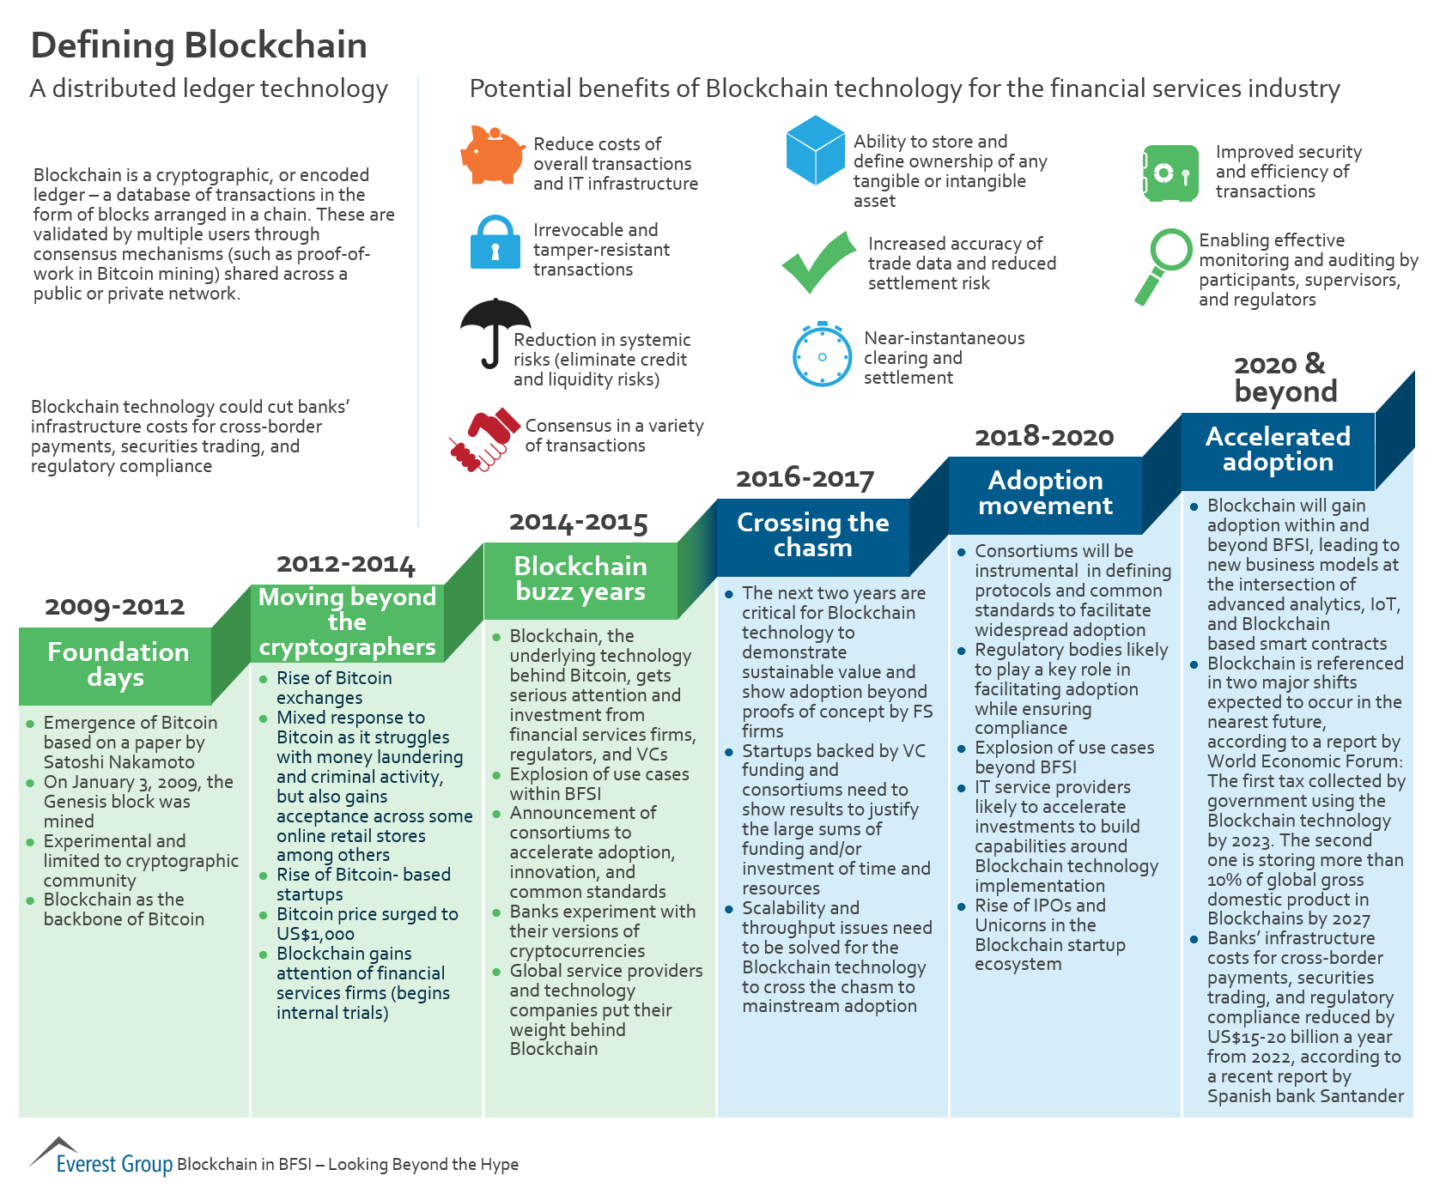
Blockchain: Distributed Ledger Technology Everest Group

Slide 12
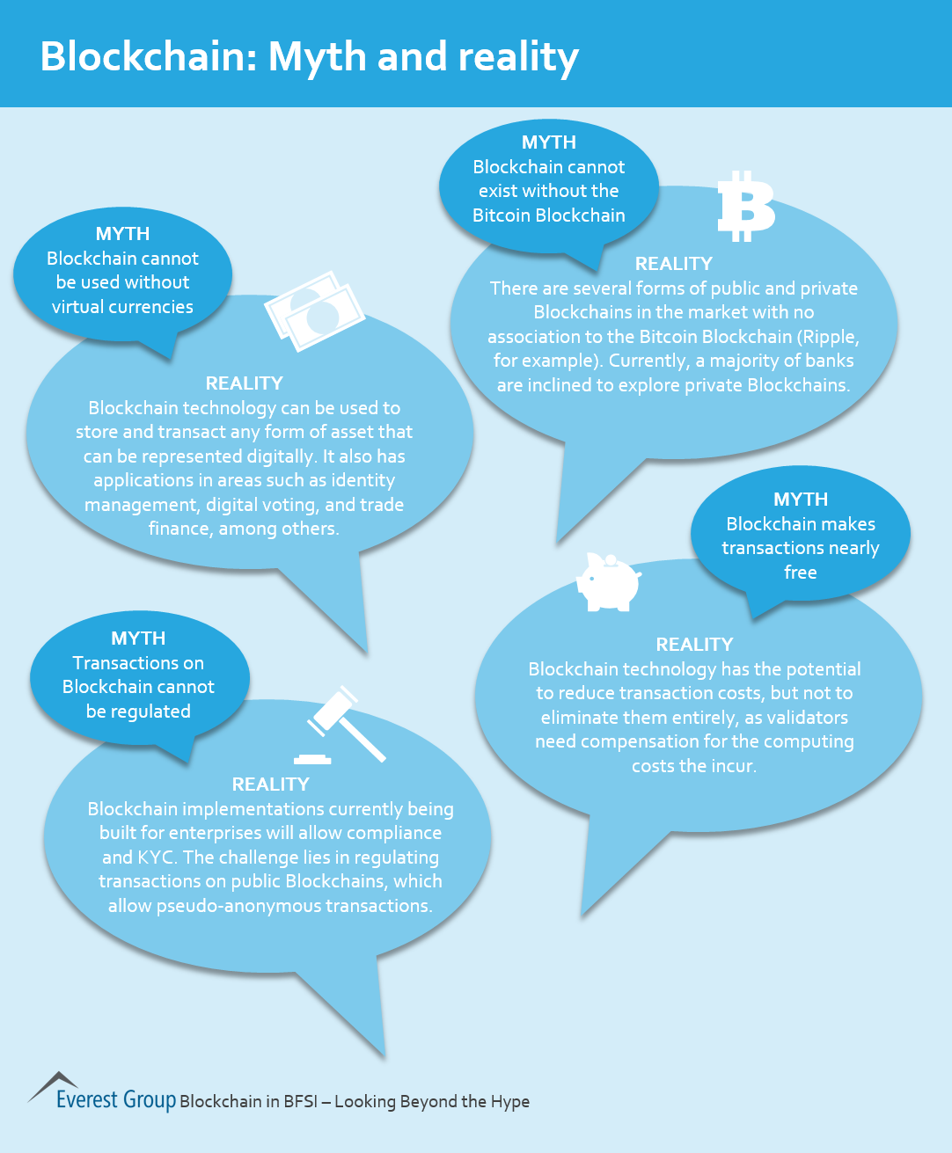
Blockchain: Myth & Reality Everest Group

Slide 13
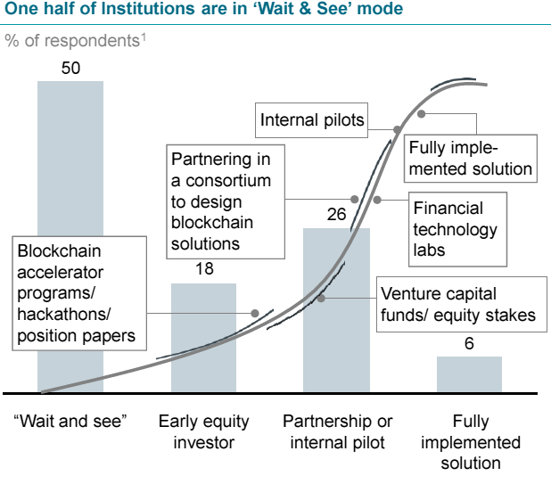
McKinsey Survey of Finance Execs Early 2016
Source:https://www.treasury.gov/initiatives/fio/Documents/McKinsey_FACI_Blockchain_in_Insurance.pdf

Slide 14
Blockchain Applications
Track provenance, ownership, relationships & lineage of assets
Supply Chain – Food Safety (Walmart), Logistics (Maersk)
Insurance Claims
Know Your Customer
Derivatives Processing
Trade/Channel Finance (IGF)
Trade Information Warehouse (DTCC)
Post-Trade Reconciliation/Settlement
Private Equity Fund Management (Unigestion)
Syndicated Loans
Diamond/Valuables Tracking and Protection – Provenance Management (Everledger)
Cross-Border Payment, Payments for/by Unbanked Populations
Low volume stock trading (JPX)
“Blockchain Revolution: How the Technology Behind Bitcoin Is Changing Money, Business, and the World”, Don Tapscott, Alex Tapscott, ISBN 978-1101980132.

Slide 15
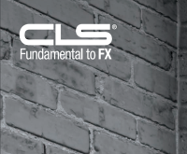
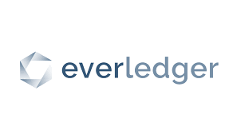

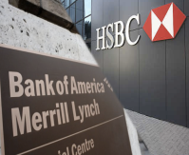




Client/Application Examples
Crédit Mutuel Arkéa
CLS
Diamond Provenance
FX Netting
Identity Management
BAML
HSBC
IBM
Global
Financing
Credit Default Swaps
Trade Finance
Channel Financing
Japanese
Stock
Exchange
Low Liquidity Securities Trading & Settlement
Food Safety
Health Data Exchange

Slide 16
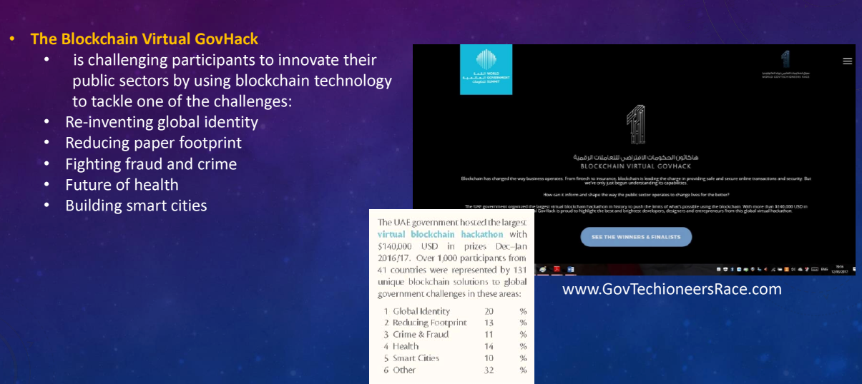
UAE Initiatives Supporting Blockchain
Source: Saeed Al Dhaheri, Etisalat Academy 3/2017

Slide 17
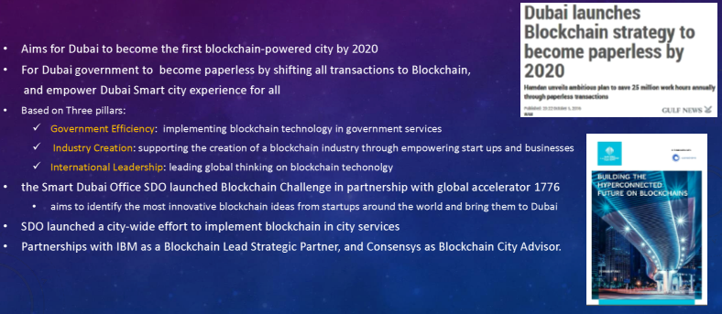
Dubai Blockchain Strategy
Source: Saeed Al Dhaheri, Etisalat Academy 3/2017

Slide 18
Dubai Blockchain Strategy
Source: Saeed Al Dhaheri, Etisalat Academy 3/2017

Slide 19
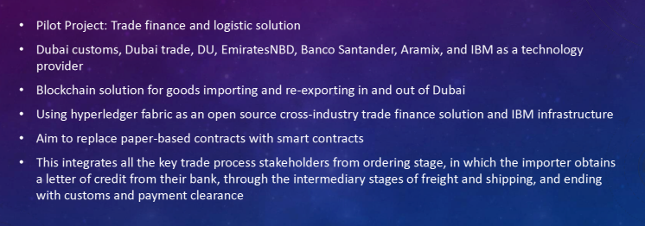
Dubai Blockchain POC Project
Source: Saeed Al Dhaheri, Etisalat Academy 3/2017

Slide 20
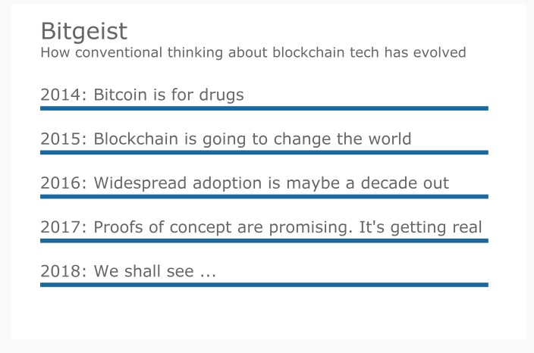
Blockchain Roadmap
Source: American Banker 3-2017

Slide 21
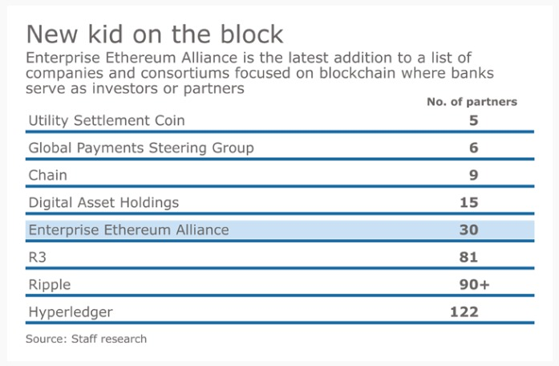
Blockchain Companies/Consortia & Banks
Source: American Banker 2-2017

Slide 22
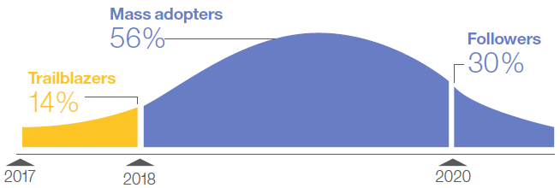
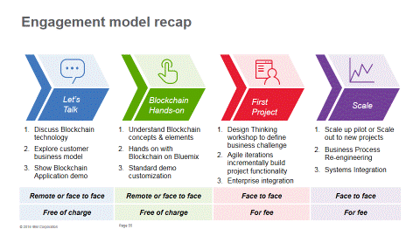




Adoption Indicators
Survey Readout
Practitioner Readout
Operator Readout
14%
in FSS survey of 200 expect to go production at scale with Blockchain in 2017
400+
Client engagements on IBM Blockchain
4
Networks launched
on IBM Blockchain
Report: “Blockchain rewires financial markets”
IBM Institute for Business Value
IBM Blockchain Garage
https://www.ibm.com/blockchain/getting-started.html
www.ibm.com/blockchain
1.2M diamonds today on the IBM Blockchain Platform

Slide 23
Ongoing Industry Projects/Efforts
11/2016: R3 open sources Corda
2/2017: DTCC (Depository Trust & Clearing Corp) Selects IBM, AXONI and R3 to develop DTCC's distributed ledger solution for derivatives processing – expected to go live in early 2018
2/2017: Enterprise Ethereum Alliance launched
3/2017: Fabric graduates, Incubation to Active
7/2017: V1 released
BigchainDB (Berlin): Starts from DBMS end to add BC features
Uses a single RethinkDB Cluster
MongoDB support being added

Slide 24
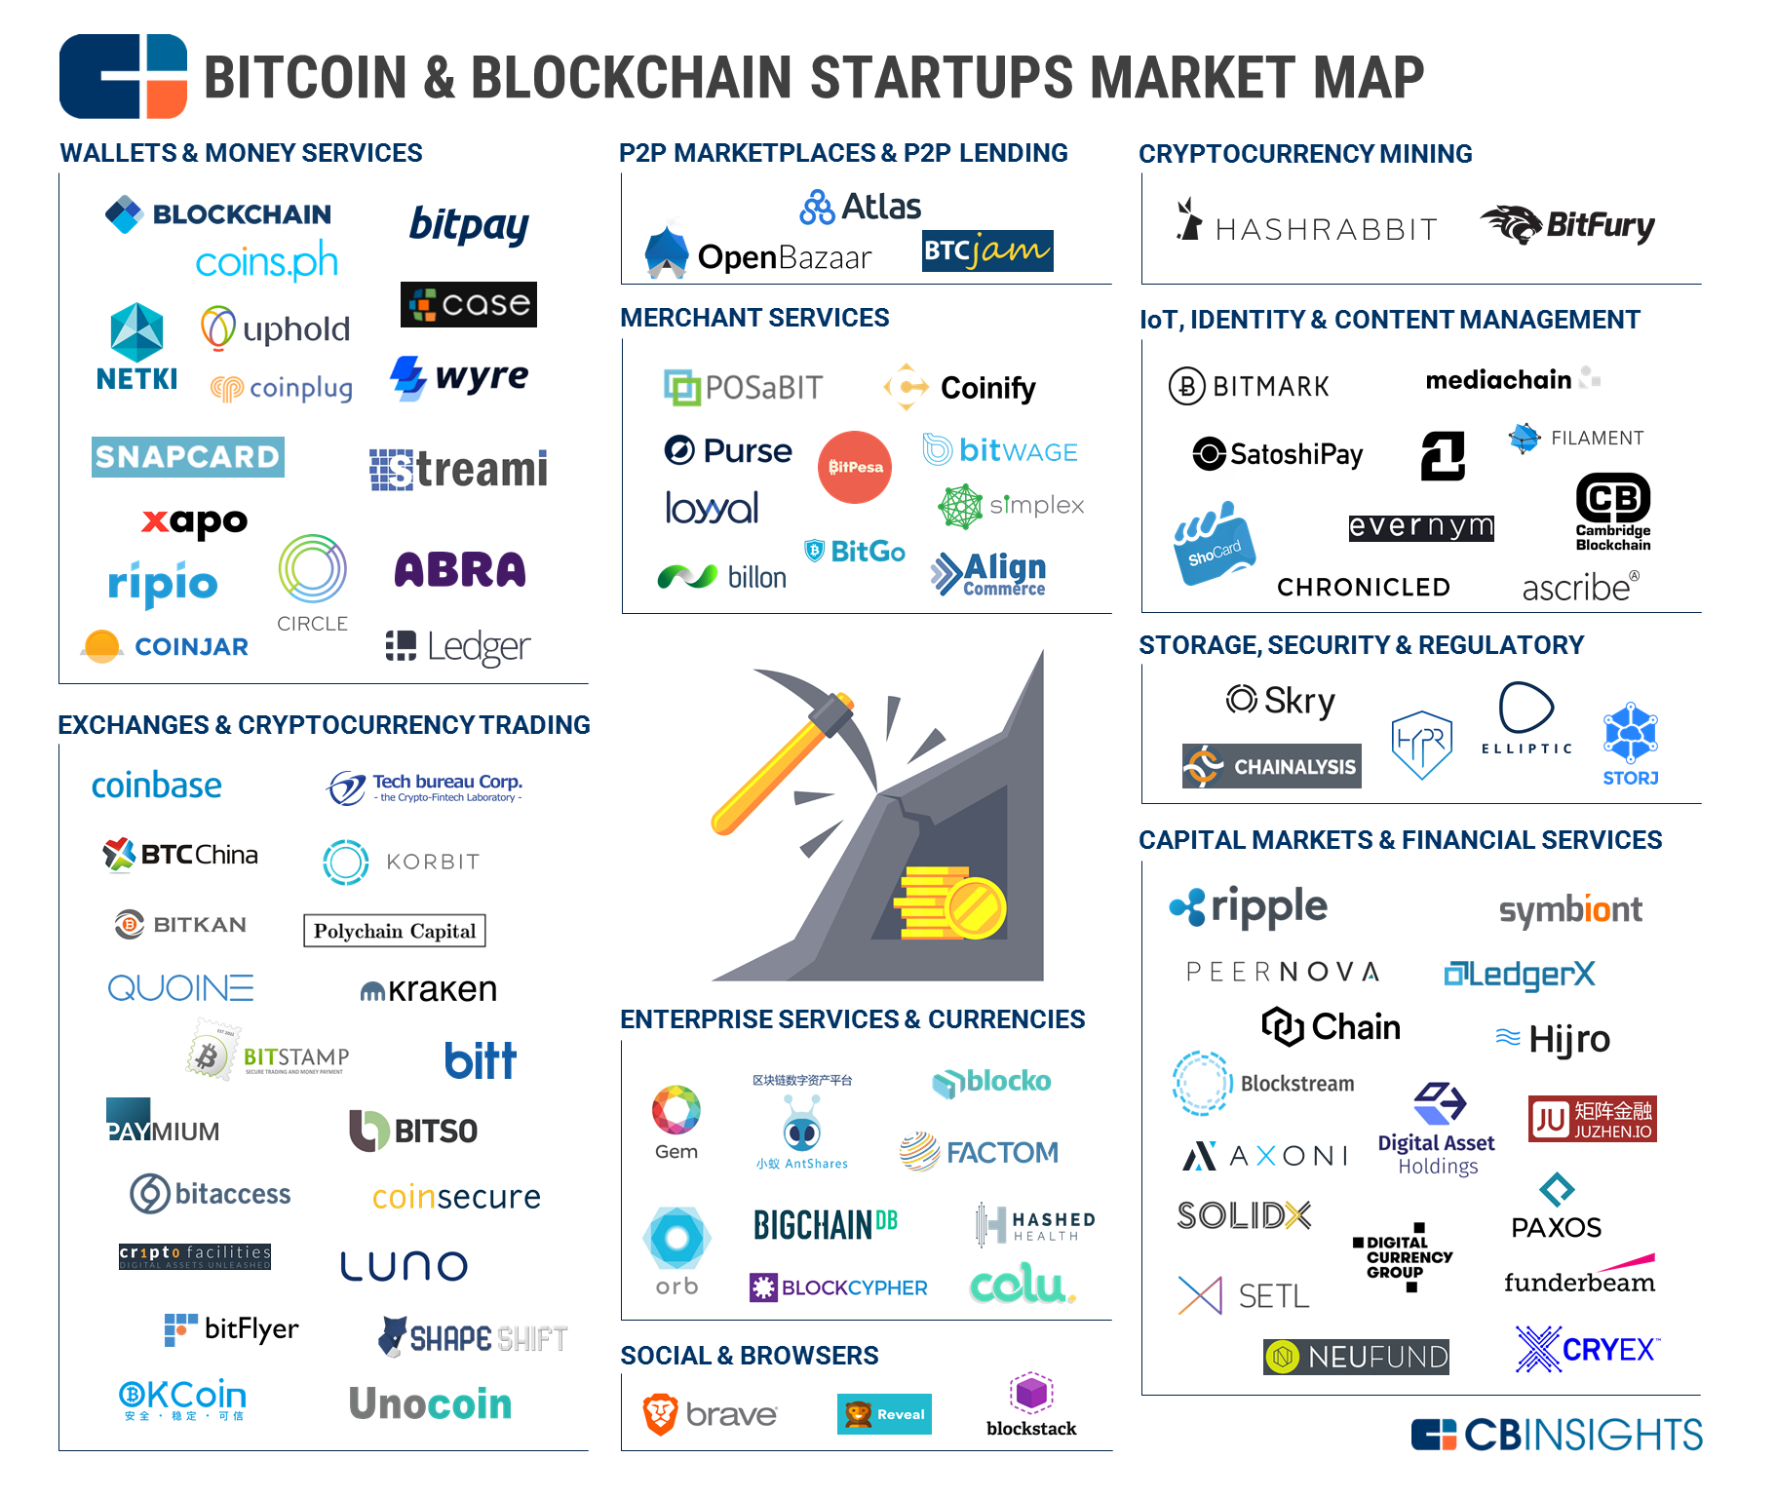
Startup Market Map 2-2017
Source: https://www.cbinsights.com/blog/bitcoin-blockchain-startup-market-map/

Slide 25
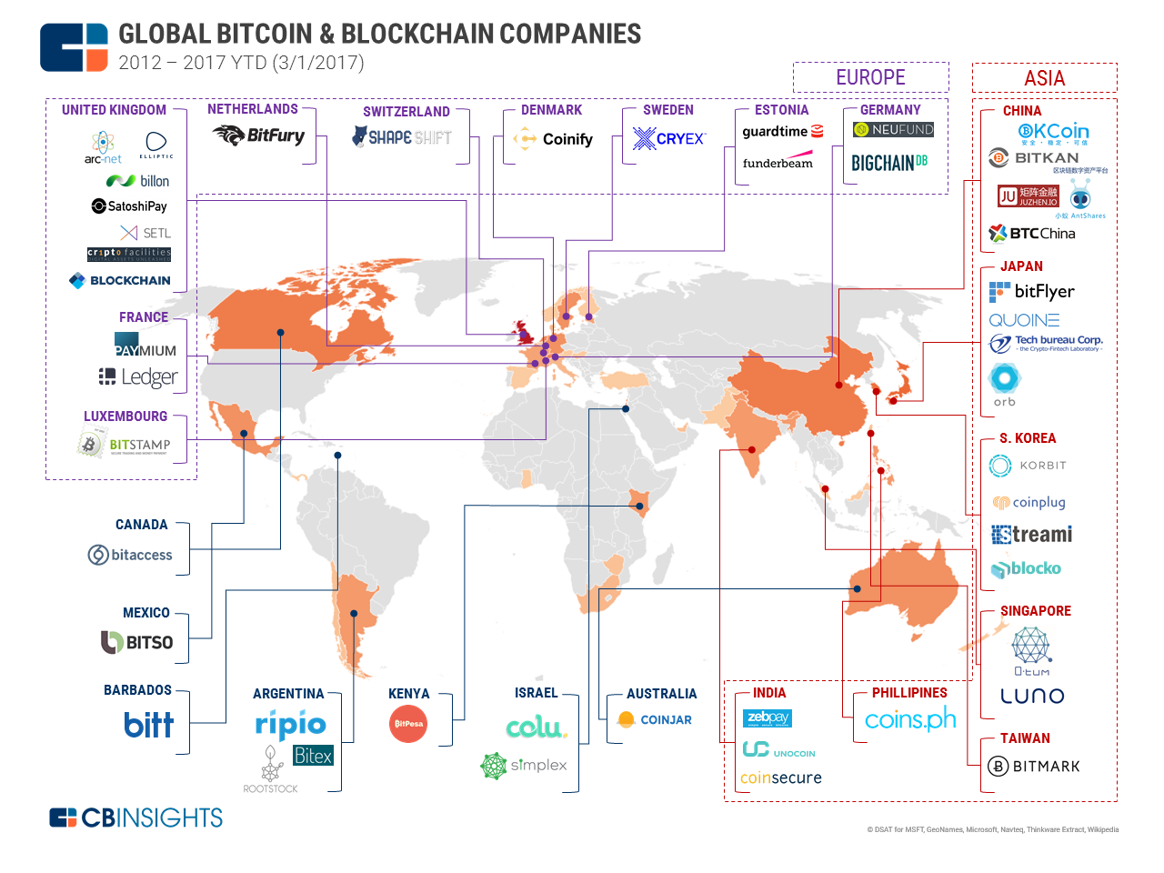
Global Bitcoin/Blockchain Companies 3/2017
Source: https://www.cbinsights.com/blog/bitcoin-blockchain-startup-global-map/

Slide 26
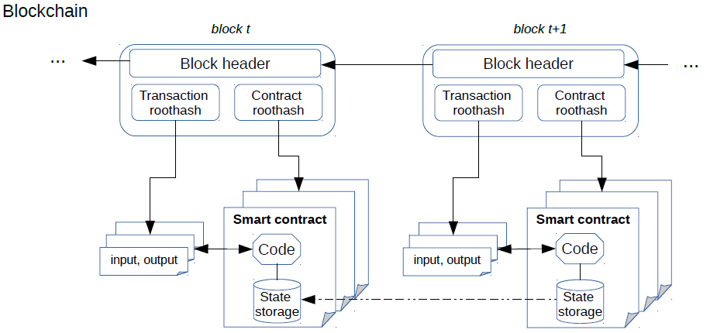
BC Software Stack
Consensus Layer (PBFT, PoW, PoS, POA, etc.)
Data Model Layer
(LevelDB, RocksDB, etc.)
Smart Contract Execution Engine
(Virtual Machine, Docker, etc.)
Source: Anh Dinh, et al., SIGMOD 2017

Slide 27
Blockchain Architecture/Feature Choices
Cryptocurrencies Vs Generalized Assets
Permissionless/Public Vs Permissioned/Private
Byzantine Vs Non-Byzantine fault model
Consensus approach: PoW, PoA, PoET, PBFT, …
SQL Vs NoSQL data stores
Transactional stores Vs Non-transactional stores
Versioned/Unversioned state database
On-Chain Vs Off-Chain data
Parallelism exploitation during different phases of transaction execution
Good Survey Paper: Untangling Blockchain: A Data Processing View of Blockchain Systems, A. Dinh et al.

Slide 28
Database Replication
Primary log replay at replica – homogeneous systems with full DB replicas, typically done for disaster recovery (DR) backup
Log capture generates DML statements from what is logged and apply executes those statements (e.g., IBM Q Replication)
Can handle non-determinism and partial replicas
Requires dependency analysis to leverage parallelism at apply time
https://www.ibm.com/developerworks/data/roadmaps/qrepl-roadmap.html
Capture DML statements as issued by application and re-execute them at replica (e.g., H-Store/VoltDB)
Cannot handle non-determinism
Typically, serial execution of transactions
Upfront (fairly random, unoptimized) ordering of transactions in blockchain systems – leads to all sorts of issues!

Slide 29
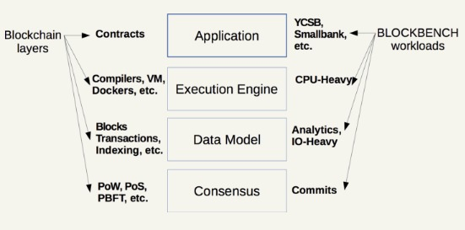
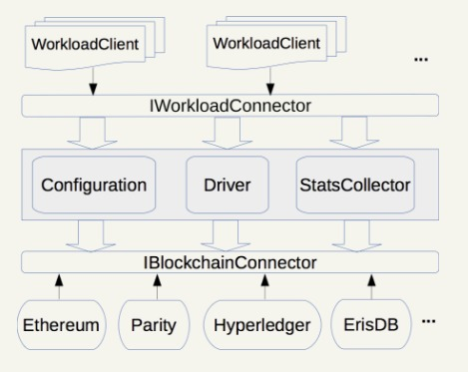
Benchmark Framework: BLOCKBENCH (NUS)
OLTP & OLAP load measured
Metrics: throughput, latency, scalability, fault tolerance, security
Consensus methods: Ethereum (PoW), Fabric (PBFT), Parity (PoA)
Old version of Fabric (pre-V1)
Fabric performs better
Fabric scales well up to 16 nodes
Source: Anh Dinh, et al., SIGMOD 2017

Slide 30
Ethereum
Public BC like Bitcoin
Extends it with Smart Contracts
Uses PoW for consensus
Own machine lang & VM
gas charging!
Most apps relate to its currency Ether
Enterprise Ethereum Alliance (EEA): JPMorgan Chase, Microsoft, Intel, Accenture, Banco Santander, BNY Mellon, ConsenSys, Credit Suisse, ING, Thomson Reuters, UBS, Wipro
EEA will add confidentiality (Quorum), scalability (pluggable consensus) and permissioning to Ethereum
Focus on specification, EntEth 1.0 with Python reference client, benchmarking, compliance testing and tools
Develop standards for Ethereum: best practices, security, privacy, scalability, interoperability
Quorum from JPMorgan

Slide 31
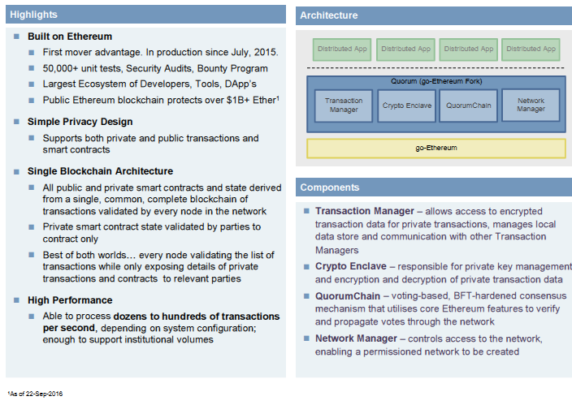
Quorum Overview J.P. Morgan

Slide 32
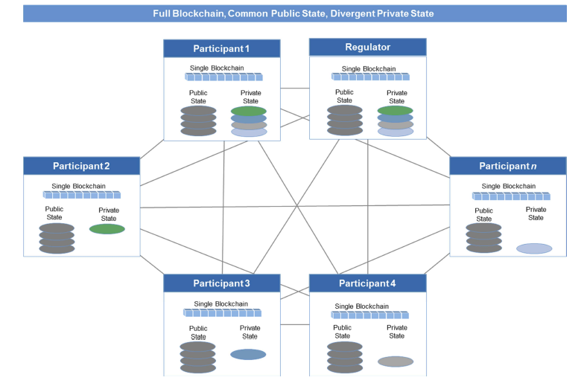
Quorum Network J.P. Morgan

Slide 33


Linux Foundation’s Hyperledger Project
Open Ledger Project announced December 17, 2015 with 17 founders, now over 100 members
Hyperledger Project rebrand in February 2016
Collaborative effort to advance Blockchain technology by identifying and addressing important features for a cross-industry open standard for distributed ledgers that can transform the way business transactions are conducted globally
Open source, open standards, open governance
QUICK FACTS
Enable adoption of shared ledger technology at a pace and depth not achievable by any one company or industry
www.hyperledger.org

Slide 34
Hyperledger Fabric Project
Initiated by IBM with IBM open source ledger contribution http://hyperledger-fabric.readthedocs.io/en/latest/
Significant change in architecture from V0.6 to V1
Chaincode trust flexibility
Scalability
Confidentiality
Consensus modularity
Used PBFT for consensus before V1 Miguel Castro, Barbara Liskov: Practical Byzantine Fault Tolerance and Proactive Recovery. ACM Trans. Comput. Syst. (TOCS), 20(4), 2002.
Other Hyperledger Projects: Iroha, Sawtooth, Composer, … https://www.hyperledger.org/
Customers doing trials: Bank of Tokyo, London Stock Exchange, Maersk, Northern Trust, Walmart

Slide 35
Fabric V1 Architecture
Elements of the Architecture
Chaincode: System and regular ones. Deploy and Invoke latter.
State: Versioned KV model - stored in Level DB or CouchDB
Ledger data: Blockchain has full state, including history
Transactions
Kafka for Ordering:
No Byzantine fault handling
Done to improve performance
Pluggable consensus permits other methods

Slide 36
Fabric V1 Ledger
Replaceable
Transaction Log
State Database
tx array
CouchDB (external option) supports keyed queries, composite key queries, key range queries, plus full data rich queries (beta in 1.0)
Latest written key/values for use in transaction simulation
Supports keyed queries, composite key queries, key range queries
block
TX
Reads[]
Writes[]
Last written key/value
TX
Reads[]
Writes[]
Key History index
TX
Reads[]
Writes[]
tracking history of a key
Block index
TX
Reads[]
Writes[]
blockHash → SegNo + offset
blockNum → SegNo + offset
txId → SegNo + offset
File System
Level DB
Notes:
Experiment with couchdb

Slide 37
Hyperledger Fabric V1 Components
Hyperledger Fabric enables the creation of blockchain networks that protect information with the accountability needed by regulated businesses.
Hyperledger Fabric is implemented as a modular architecture, consisting of the following components:
CLIENT
SDK
MEMBERSHIP
LEDGER
CHAINCODE
CONSENSUS
Enables the creation of applications that deploys and invokes transactions atop a shared ledger.
Support is provided for both Node.js or Java SDK
Provides a specialized digital certificate authority for issuing certificates to members of the blockchain network
Leverages cryptographic functions provided by Hyperledger Fabric
Provides a distributed encrypted ledger, including an append-only data store. Provides ability to query, and write data across distributed ledgers
Transactions logic is written as chaincode (in the Go or Java languages).
Chaincode executes in Docker containers
Service enabling digitally signed transactions to be proposed and validated by network members

Slide 38
Fabric V1 Reference Architecture
IDENTITY
Pluggable, Membership, Privacy and Auditability of transactions.
LEDGER | TRANSACTIONS
Distributed transactional ledger whose state is updated by consensus of stakeholders
SMART CONTRACT
“Programmable Ledger”, provide ability to run business logic against the blockchain (aka smart contract)
APIs, Events, SDKs
Multi-language native SDKs allow developers to write DLT apps
APIs, Events, SDKs
IDENTITY
LEDGER
TRANSACTIONS
SMART CONTRACT
Distributed Ledger Technology Services
Membership Services
Consensus Services
Chaincode
Services
AP
Distributed Ledger
Ordering Service
Secure
Container
Enrollment
Attributes
Network Protocol
Endorsement
Validation
Secure
Registry
Security and Crypto Services

Slide 39
Transaction Execution Overview Fabric V1
3 Stage Execution: Endorsement, Ordering, Validation/Commit
Transaction is sent to the counter-parties represented by Endorsing Peers on their Channel
Each Peer simulates transaction execution by calling specified Chaincode function(s) and signs result (Read-Write Sets)
Each Peer may participate in multiple channels allowing concurrent execution
Ordering Service accepts endorsed transactions and orders them according to the plug-in consensus algorithm then delivers them on the channel
All (Committing) peers on channel receive transactions: on successful validation, commit to ledger. No chaincode execution.
Endorsing Peer
Client
Invoke Chaincode
Receive Read and Write Sets
Send tran to Ordering Service
Hear back final outcome
1
chaincode
3
chaincode
2
Ordering
Service
Channel
1
Endorsing Peer
3
3
Committing Peer

Slide 40
V1 Channels Provide Data Partitioning
SDK or the CLI can create separate channels which will isolate and segregate transactions and ledger.
Chaincode is installed on peers that need to access the asset states to perform reads and writes
Chaincode is instantiated on specific channels for specific peers
Ledgers exist in the scope of a channel
Ledgers may be shared across entire network of peers
Ledgers may be only on a specific set of participants
Peers can participate in multiple channels
E₀
O
O
O
O
E₁
Ordering-Service

Slide 41
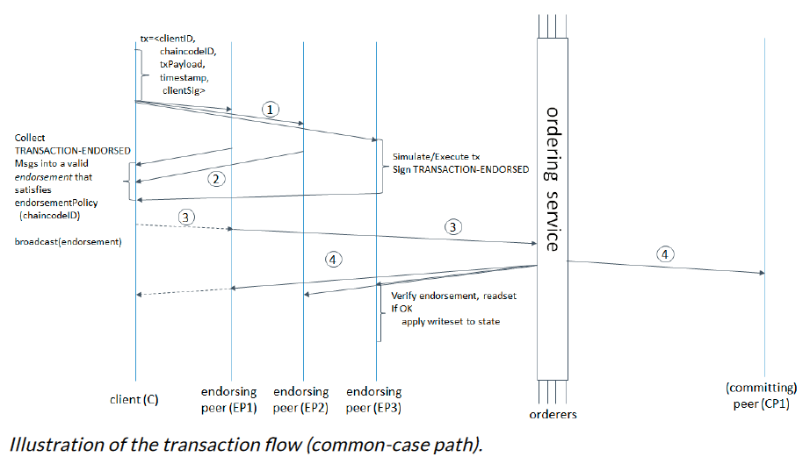
Fabric V1 Transaction Flow

Slide 42
DBMS Implications
Simulation concept requires layer between chaincode and State DB having to take on analysis of DBMS calls
Update statements split into two: read part and write part
Read alone sent to DBMS with modifications to retrieve version #s for items read
Writes not sent to DBMS but processed and cached locally – doesn’t allow for read your own write by chaincode transaction
During Commit phase, read sets validated by retrieving each item’s version # individually and then, if validation succeeds, writes also done one at a time
Dealing with phantoms requires reexecution of query during commit phase to be sure simulation read set same as read set at Commit time
Chaincode portability across different State DBMSs hard to do
Lots of open questions and research issues in this area

Slide 43
R3 Alliance & Corda
Barclays, BBVA, Commonwealth Bank of Australia (CBA), Credit Suisse, J.P. Morgan, State Street, Royal Bank of Scotland, UBS
Special features for JVM to guarantee deterministic behavior
Hearn, M. Corda: A distributed ledger, Version 0.5, November 2016. https://docs.corda.net/_static/corda-technical-whitepaper.pdf
Nodes backed by RDBMS, ledger data SQL queryable and joinable with private tables
Corda written in Kotlin (simpler Scala with much better Java interoperability) from JetBrains – contracts in Kotlin/Java
Contract execution is deterministic and its acceptance of a transaction is based on the transaction’s contents alone. A transaction is only valid if the contract of every input state and every output state considers it to be valid

Slide 44
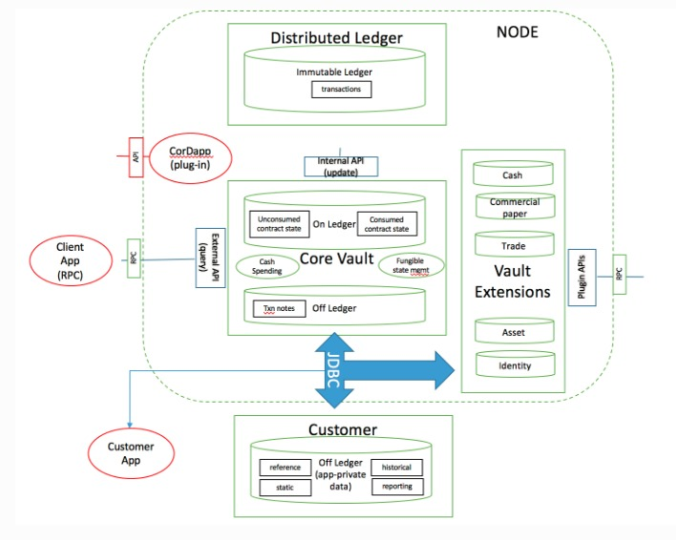
R3 Corda Vault

Slide 45
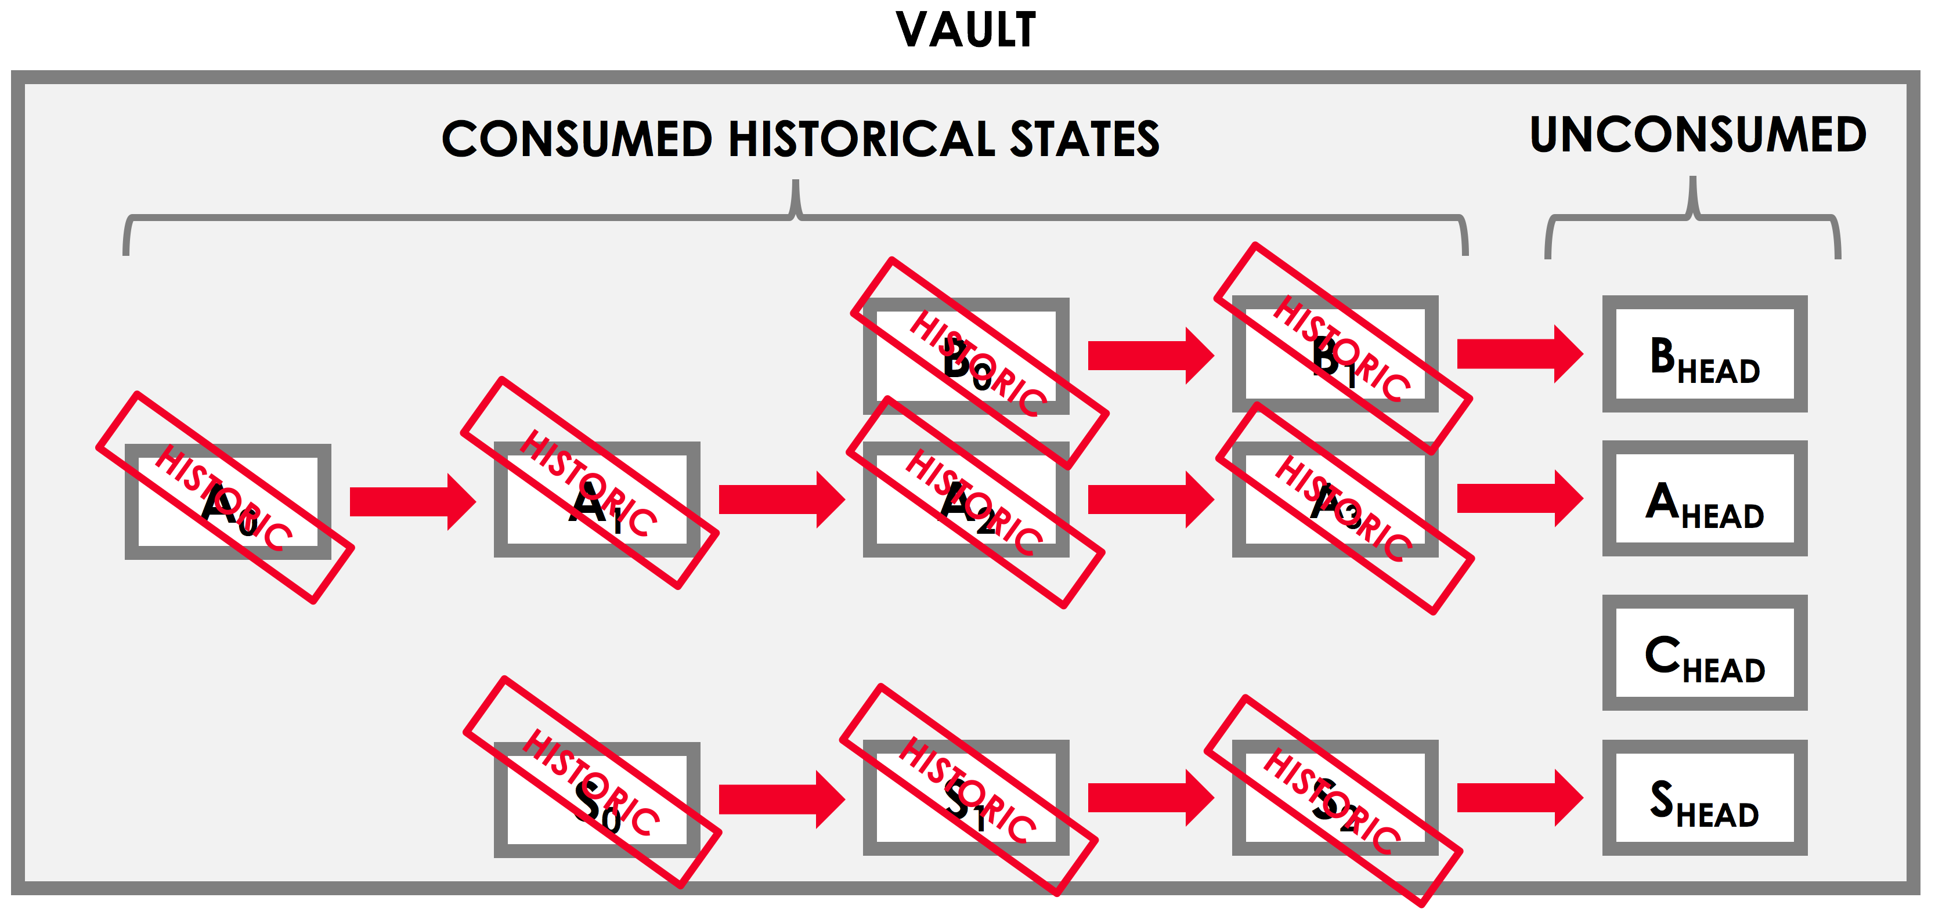
Corda Vault and State
Each node on the network maintains a vault - a DB where it tracks all the current and historic states that it is aware of, and which it considers to be relevant to itself

Slide 46
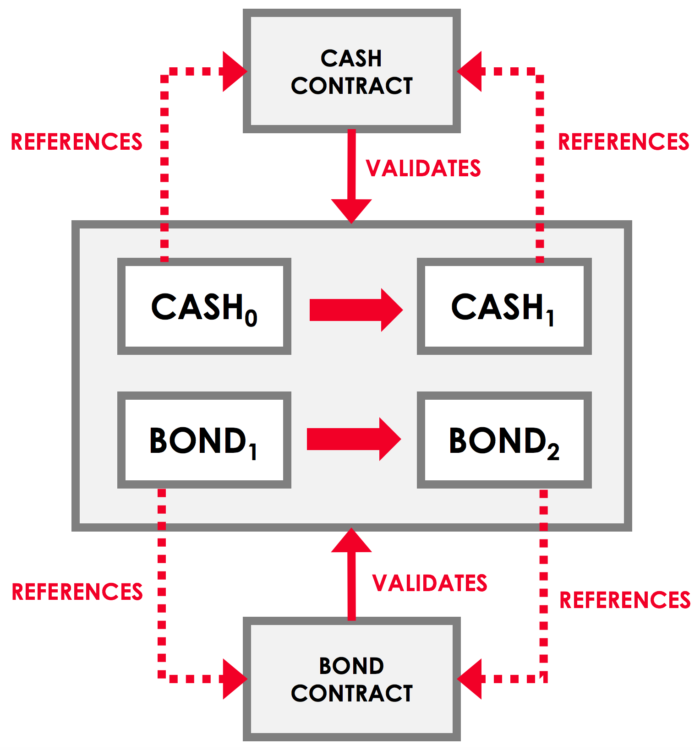
Corda Contract Validity
A transaction is only valid if it is digitally signed by all required signers. However, even if a transaction gathers all the required signatures, it is only valid if it is also contractually valid.

Slide 47
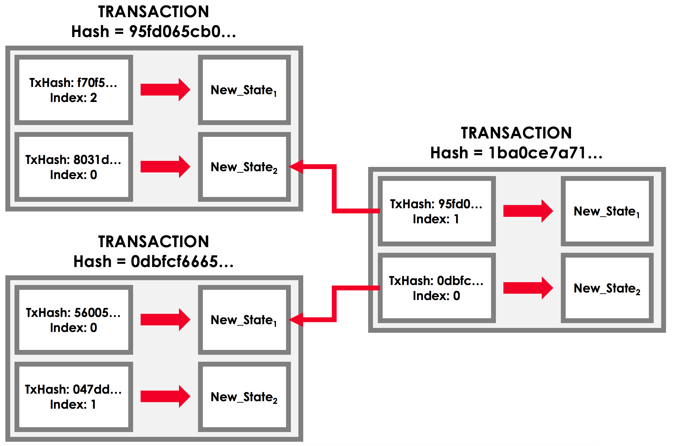
Corda Transactions
Transaction Chain
Notary and Regular Transactions
Every state has an appointed notary, and a notary will only notarize a transaction if it is the appointed notary of all the transaction’s input states.

Slide 48
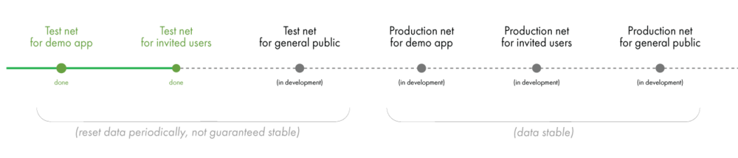
Bigchain DB
Designed to merge best of DB & blockchain worlds
Scale, permissioning and NoSQL querying from DB side
Decentralization, immutability, and assets from blockchain side
All data as JSON documents in RethinkDB/MongoDB
Intended to play well alongside decentralized file systems (e.g., IPFS) and processing (e.g., Ethereum)
Modelled around assets, and inputs and outputs are the mechanism by which control of an asset is transferred
Release 1.0 to ship 6/2017
IPDB (Interplanetary Database) Network and a Foundation for its governance - management of personal data, reputation, and privacy, along with secure attribution, metadata, licensing, and links to media files https://ipdb.foundation/

Slide 49
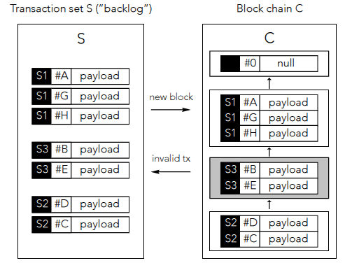
BigchainDB Architecture

Slide 50
BigchainDB
Central notion: assets
Mechanisms for asset transfer: inputs and outputs
Amount of asset encoded in outputs of a transaction
Each output might be spent separately
To spend an output, its conditions must be met by an input that provides corresponding fulfillments
Simple signature condition: asset given to entity controlling a corresponding private key

Slide 51
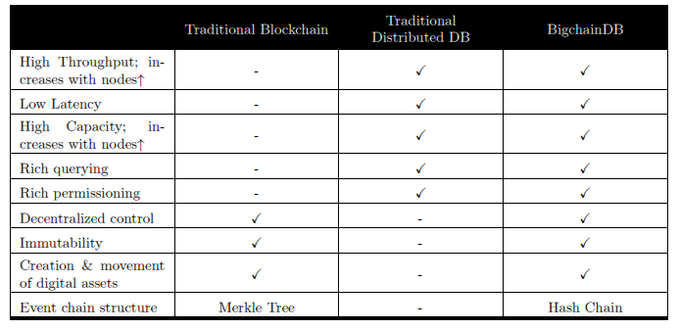
BigchainDB

Slide 52
Sawtooth (Intel)
Incubation project of Hyperledger
Proof of Elapsed Time (PoET) – Consensus Protocol
Every validator requests a wait time from a trusted function
Validator with shortest wait time for a particular transaction block is elected leader
Guaranteed wait time
Randomness in leader election (~ to lottery algorithm)
Intended to run in a Trusted Execution Environment (TEE), e.g., Intel’s Software Guard Extensions (SGX)
Currently experimental and not secure
Concept of Transaction Family and Transaction Dependencies
https://intelledger.github.io/introduction.html

Slide 53
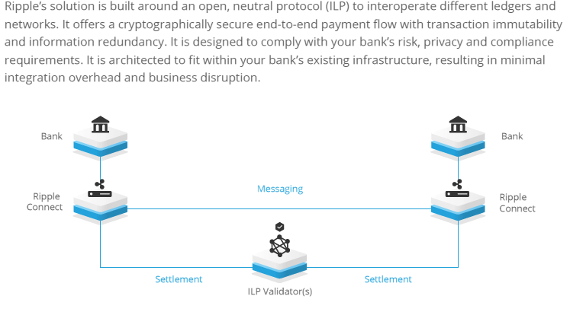
Ripple
Works with PostgreSQL 9.4 or Microsoft SQL Server 2012

Slide 54
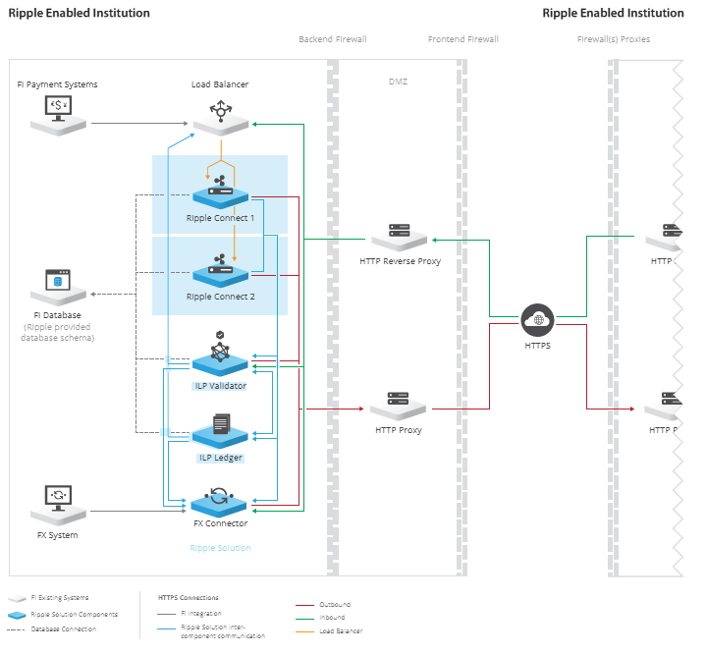
Ripple

Slide 55
Blockchain Architecture/Feature Choices
Cryptocurrencies Vs Generalized Assets
Permissionless/Public Vs Permissioned/Private
Byzantine Vs Non-Byzantine fault model
Consensus approach: PoW, PoA, PoET, PBFT, …
SQL Vs NoSQL data stores
Transactional stores Vs Non-transactional stores
Versioned/Unversioned state database
On-Chain Vs Off-Chain data
Parallelism exploitation during different phases of transaction execution

Slide 56
Application Flow with RDBMS (In Progress)
Blockchain
Developer
Develops
Application
D
Developers create application and smart contracts (chaincodes)
Chaincodes are deployed on the network and control the state of the ledger
Application handles user interface and submits transactions to the network which call chaincodes
Network emits events on block of transactions allowing applications to integrate with other systems
Accesses
SDK
Develops
Invokes/queries
Smart Contract
Emits
Event
‘SELECT’
‘INSERT’, ‘DELETE’, ‘UPDATE’
Emits
RDBMS
block
…
Cached State
txn
txn
txn
txn
Blockchain
Ledger
Peer
Notes:
Delete can only delete from the World State, not the Blockchain!
A developer will create an application and smart contract (could be different developers)
The application will invoke calls within the smart contract via the Hyperledger Fabric Client (HFC) SDK
Those calls are processed by the business logic within the smart contract
- a ‘put’ or ‘delete’ command will go through consensus protocol selected and added to the blockchain
- a ’get’ command can only read from the world state but is not recorded on the blockchain
An application can access Block information via rest APIs such as get block height

Slide 57
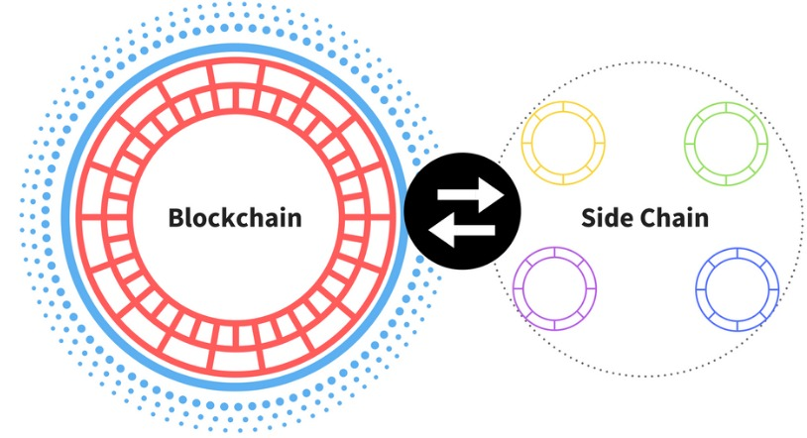
Futuristic Topics
Chaincode portability and power of data APIs
DBMS enhancements to add BC features
Standards across BC systems
Cross channel transactions
Non-deterministic actions
Analytics on chaincode data
Many app design issues
Design tools for endorsement decisions
Numerous research possibilities for database and distributed systems people in this new era of distributed computing!

Slide 58
More Information
Links to Videos, Slides, Bibliography, Twitter Handles
http://bit.ly/CMbcDB
Follow me on
Twitter: @seemohan
Facebook: http://www.facebook.com/cmohan
LinkedIn: http://www.linkedin.com/in/seemohan/

